Slide 1

Conditionals

Slide 2
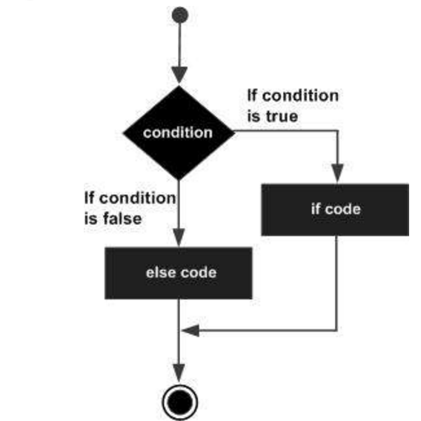
If...elif...else
Tutorialspoint.com

Slide 3
Nested Conditionals
Basically, conditional statements within conditional statements!
Example:
A card is drawn from a pack. To win, the card must be a red club or a red spade.
  Logically, the programmatic steps to determine if the card is a winner are:
    If the card is red:
      If the card is a club or the card is a spade:
        WINNER!
      If not a club or a spade:
        LOSER!
    If not red:
      LOSER!

